Slide 1
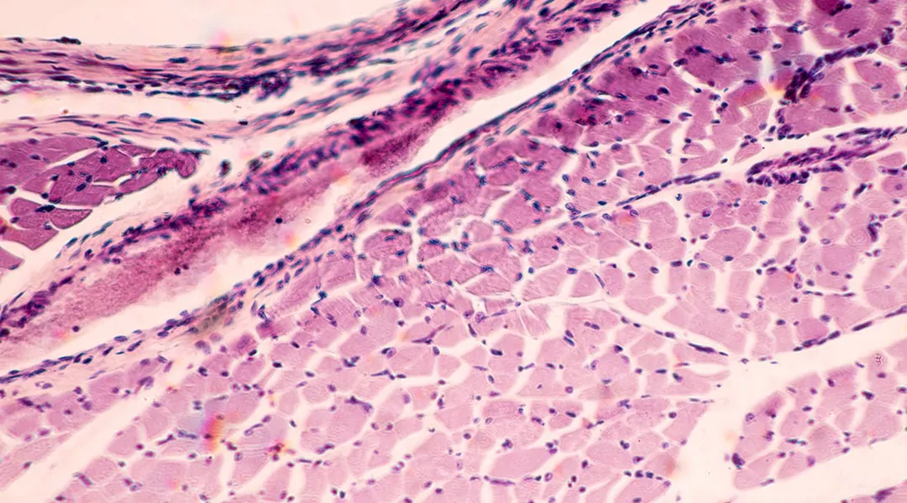
Reverting the clock
from micro to the muscle

Slide 2

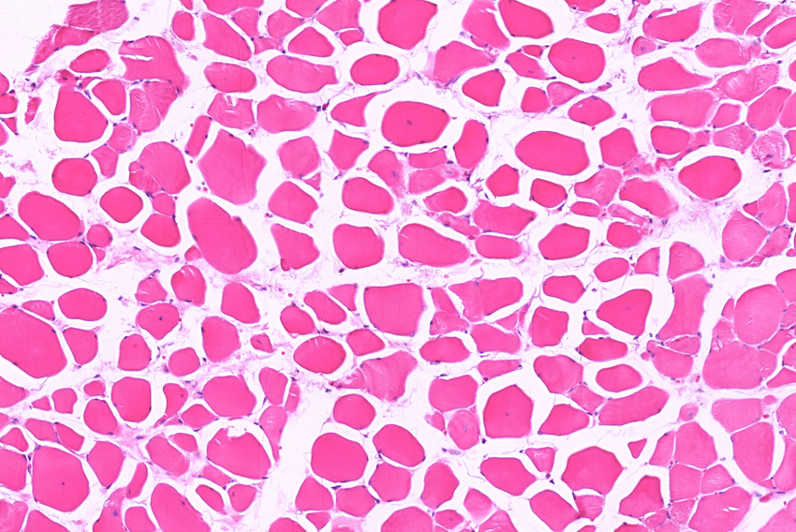
~3 – 15 %
Loss of muscle mass per decade

Slide 3


Slide 4
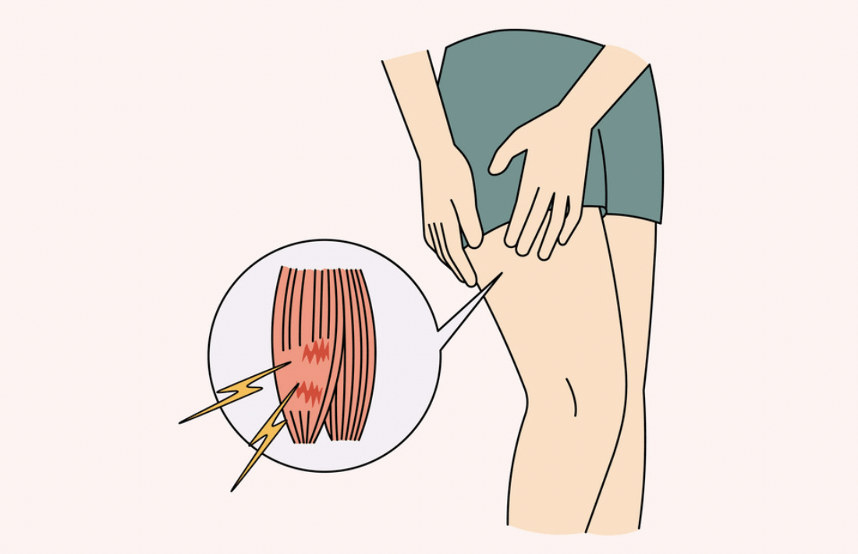
delayed onset muscle soreness (DOMS)
4

Slide 5
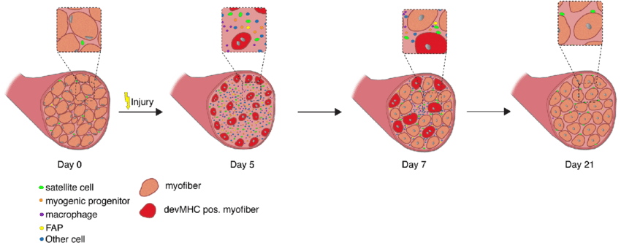
Regeneration of skeletal muscle
Notes:
https://www.researchgate.net/figure/Regeneration-of-skeletal-muscle-Time-course-of-changes-in-cellular-composition-during_fig2_332352650

Slide 6
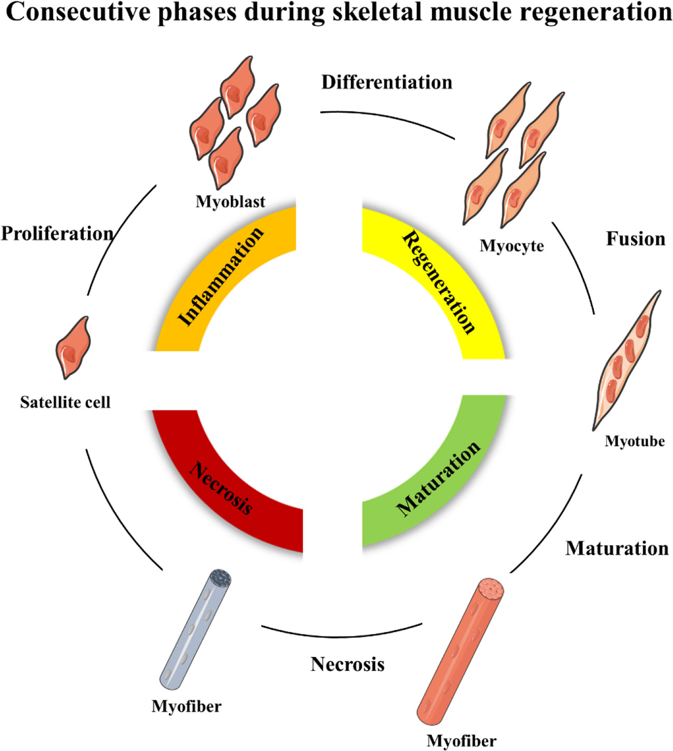

Slide 7
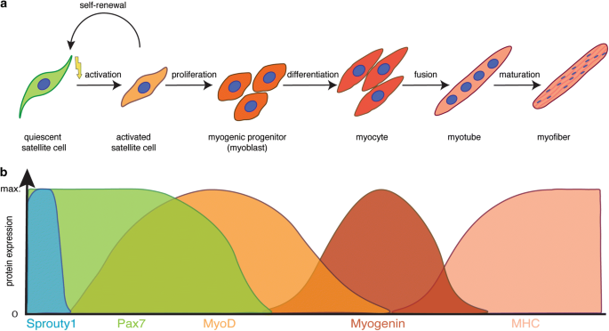

Slide 8
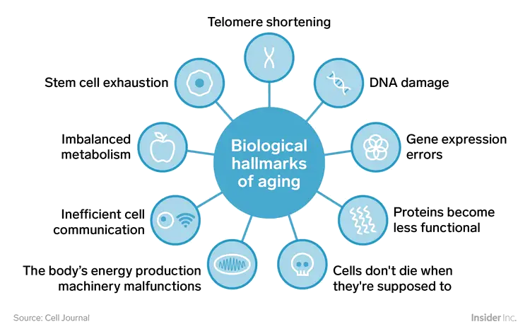
Hallmarks of aging
Notes:
https://www.businessinsider.com/biology-of-aging-why-bodies-get-old-2018-8?r=US&IR=T#errors-appear-in-dna-1

Slide 9
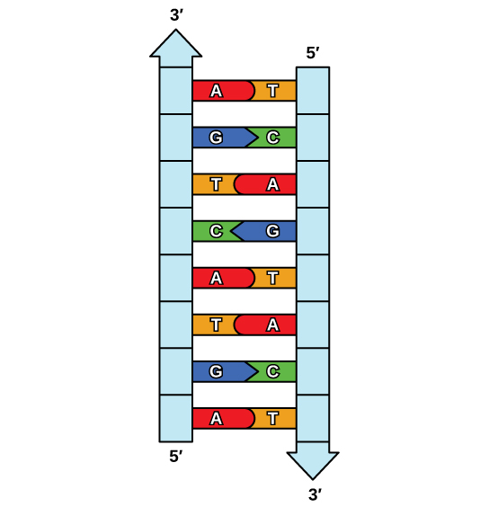
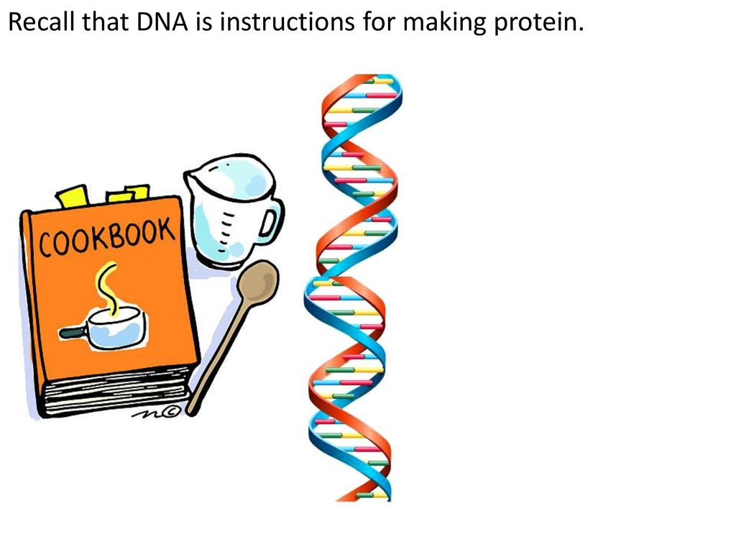
DNA
Adenine (A)
Thymine (T)
Cytosine (C)
Guanine (G)

Slide 10
DNA
Adenine (A)
Thymine (T)
Cytosine (C)
Guanine (G)

Slide 11
DNA
Adenine (A)
Thymine (T)
Cytosine (C)
Guanine (G)

Slide 12
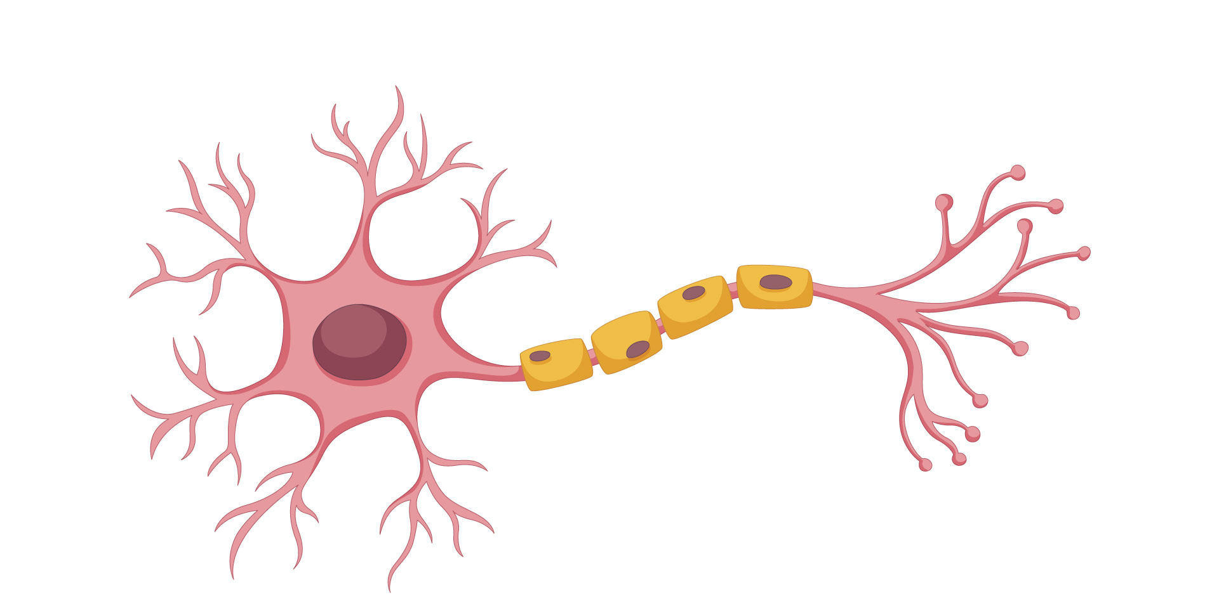
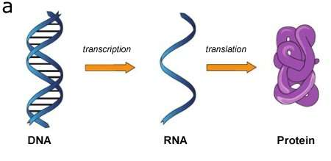


Slide 13


TRANSCIPTION REGULATION

Slide 14
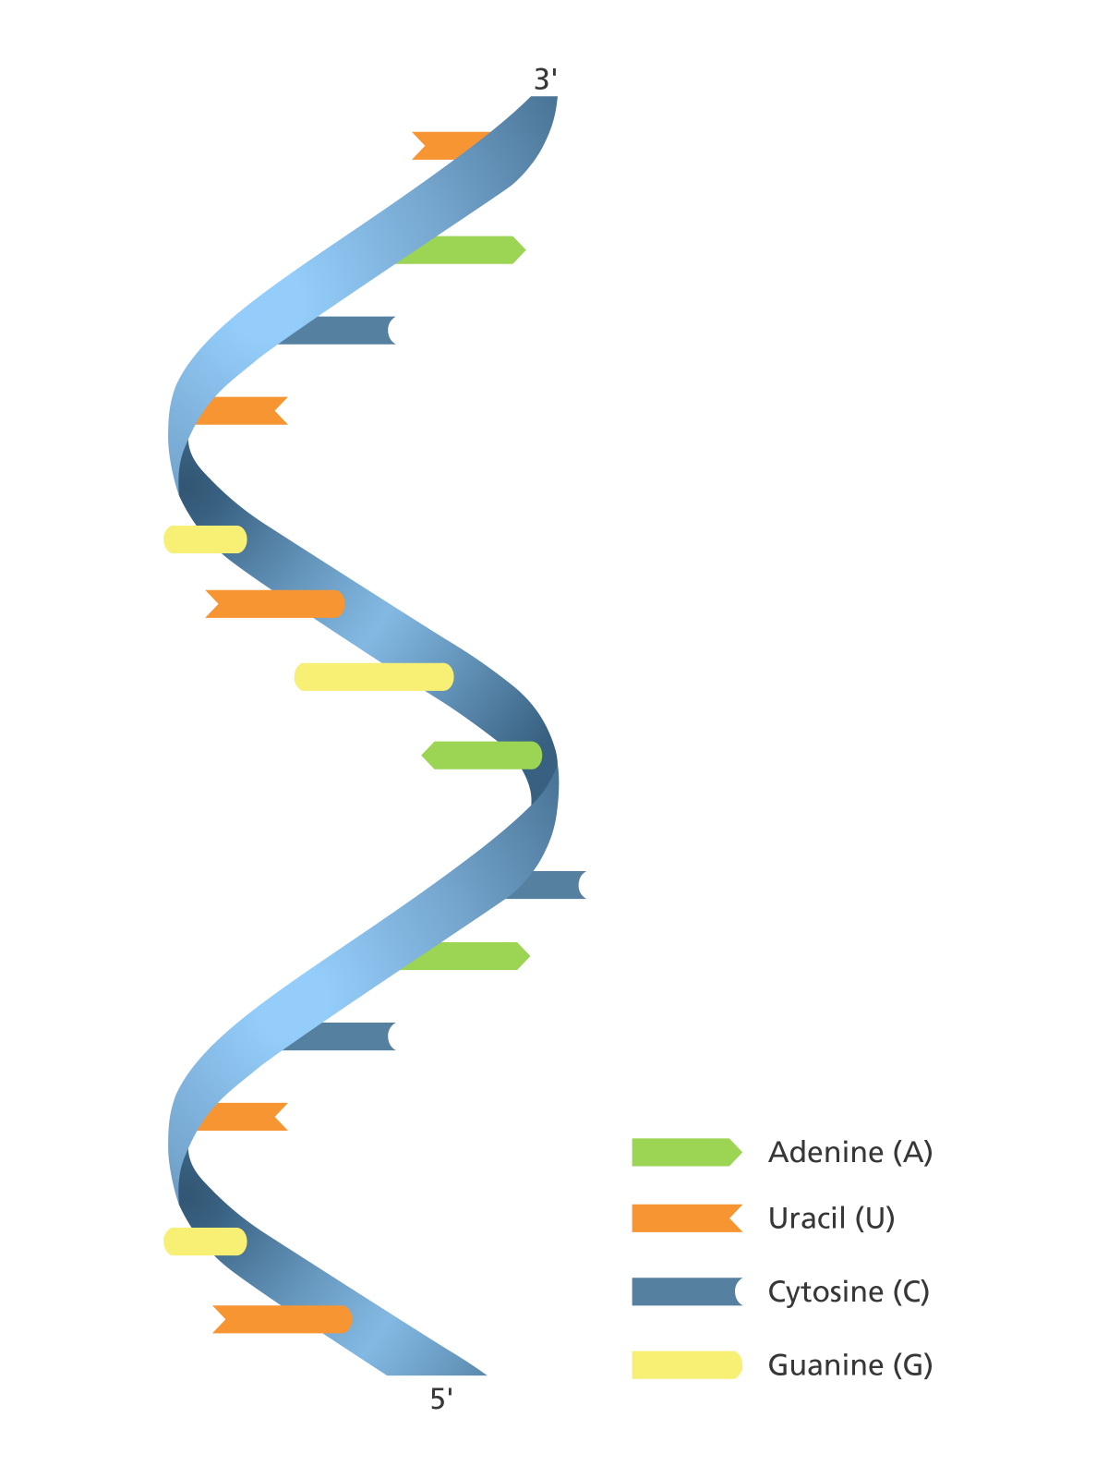

Micro RNA
SMALL
8 – 30 nucleotides long
Regulate multiple processes at the same time
Non toxic
Tend to work in groups
In comparison
DNA
Hundreds of Millions
RNA
Thousands

Slide 15
Micro RNA
SMALL
8 – 30 nucleotides long
Regulate multiple processes at the same time
Non toxic
Tend to work in groups
In comparison
DNA
Hundreds of Millions
RNA
Thousands

Slide 16
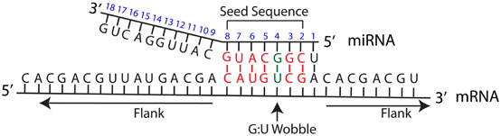
microRNAs BLOCK mRNAs BY BINDING IT

Slide 17
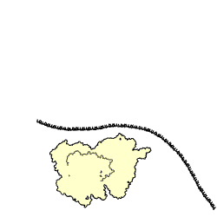
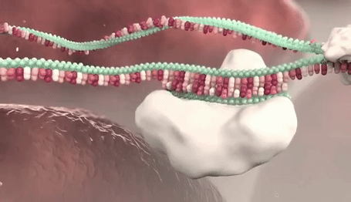

Slide 18

Hall of fame of muscle miRNAs
miR-1
miR-133
miR-206

Slide 19
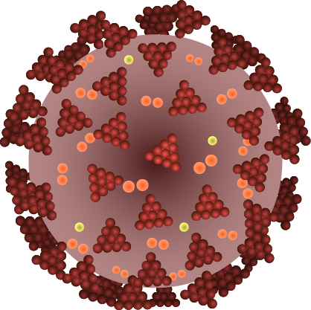
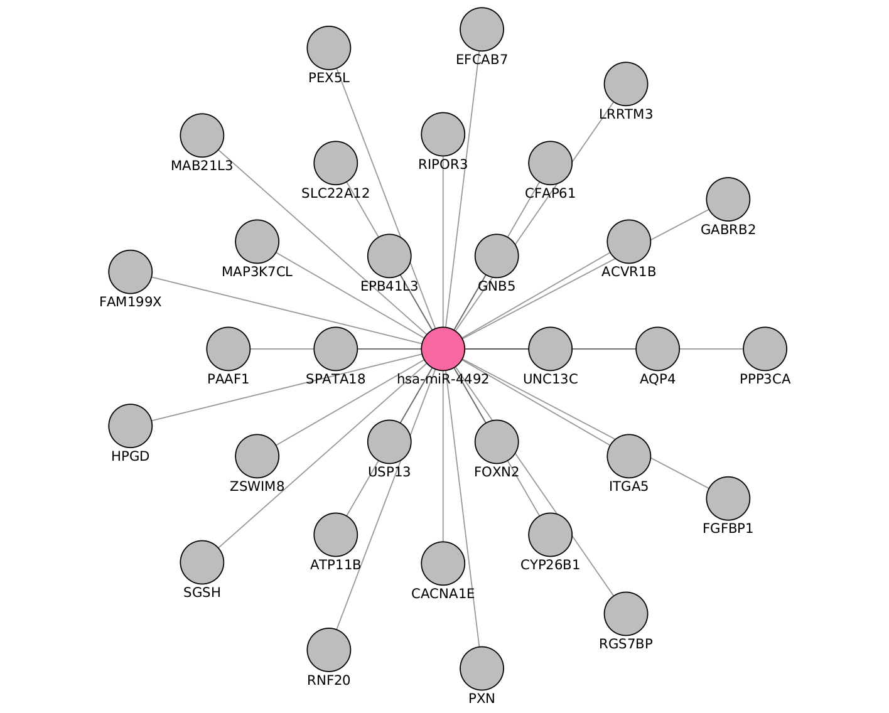
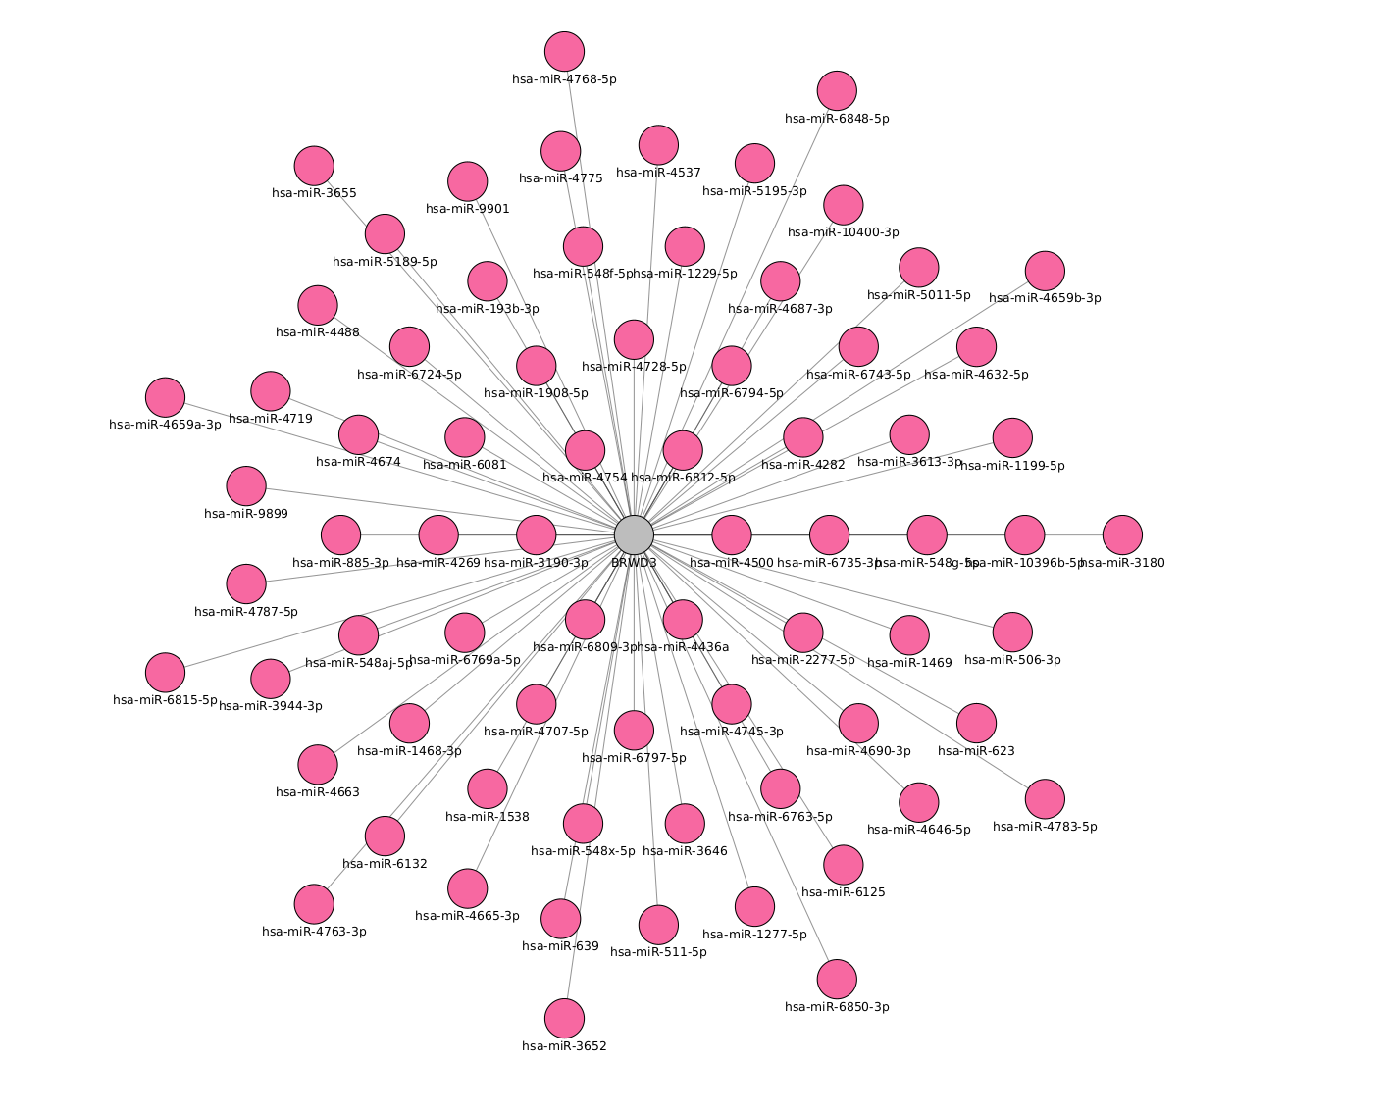

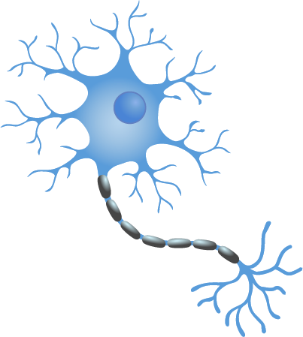

Slide 20
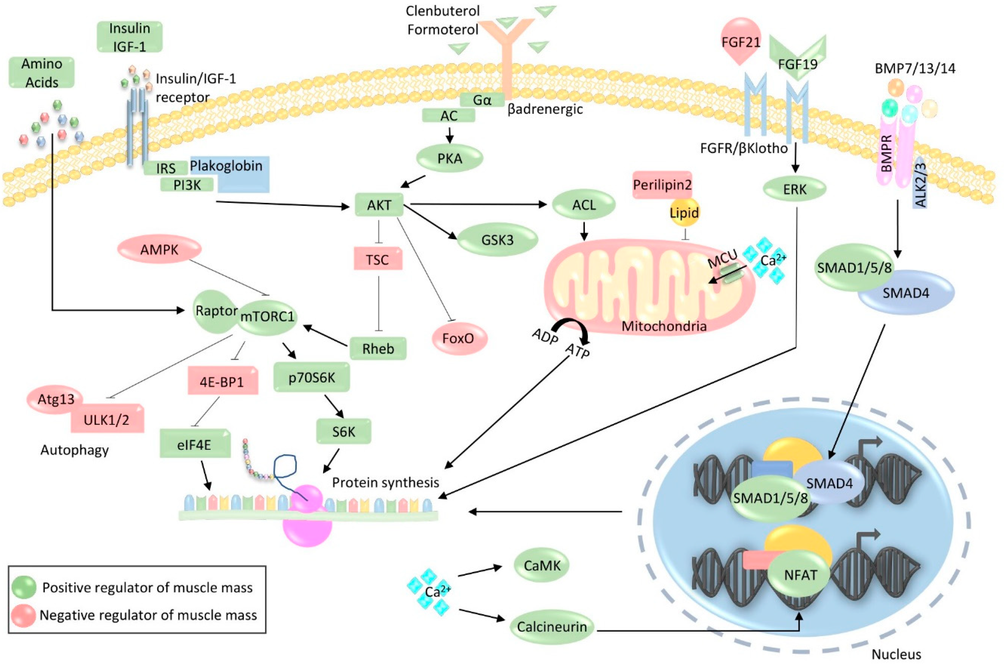

Slide 21
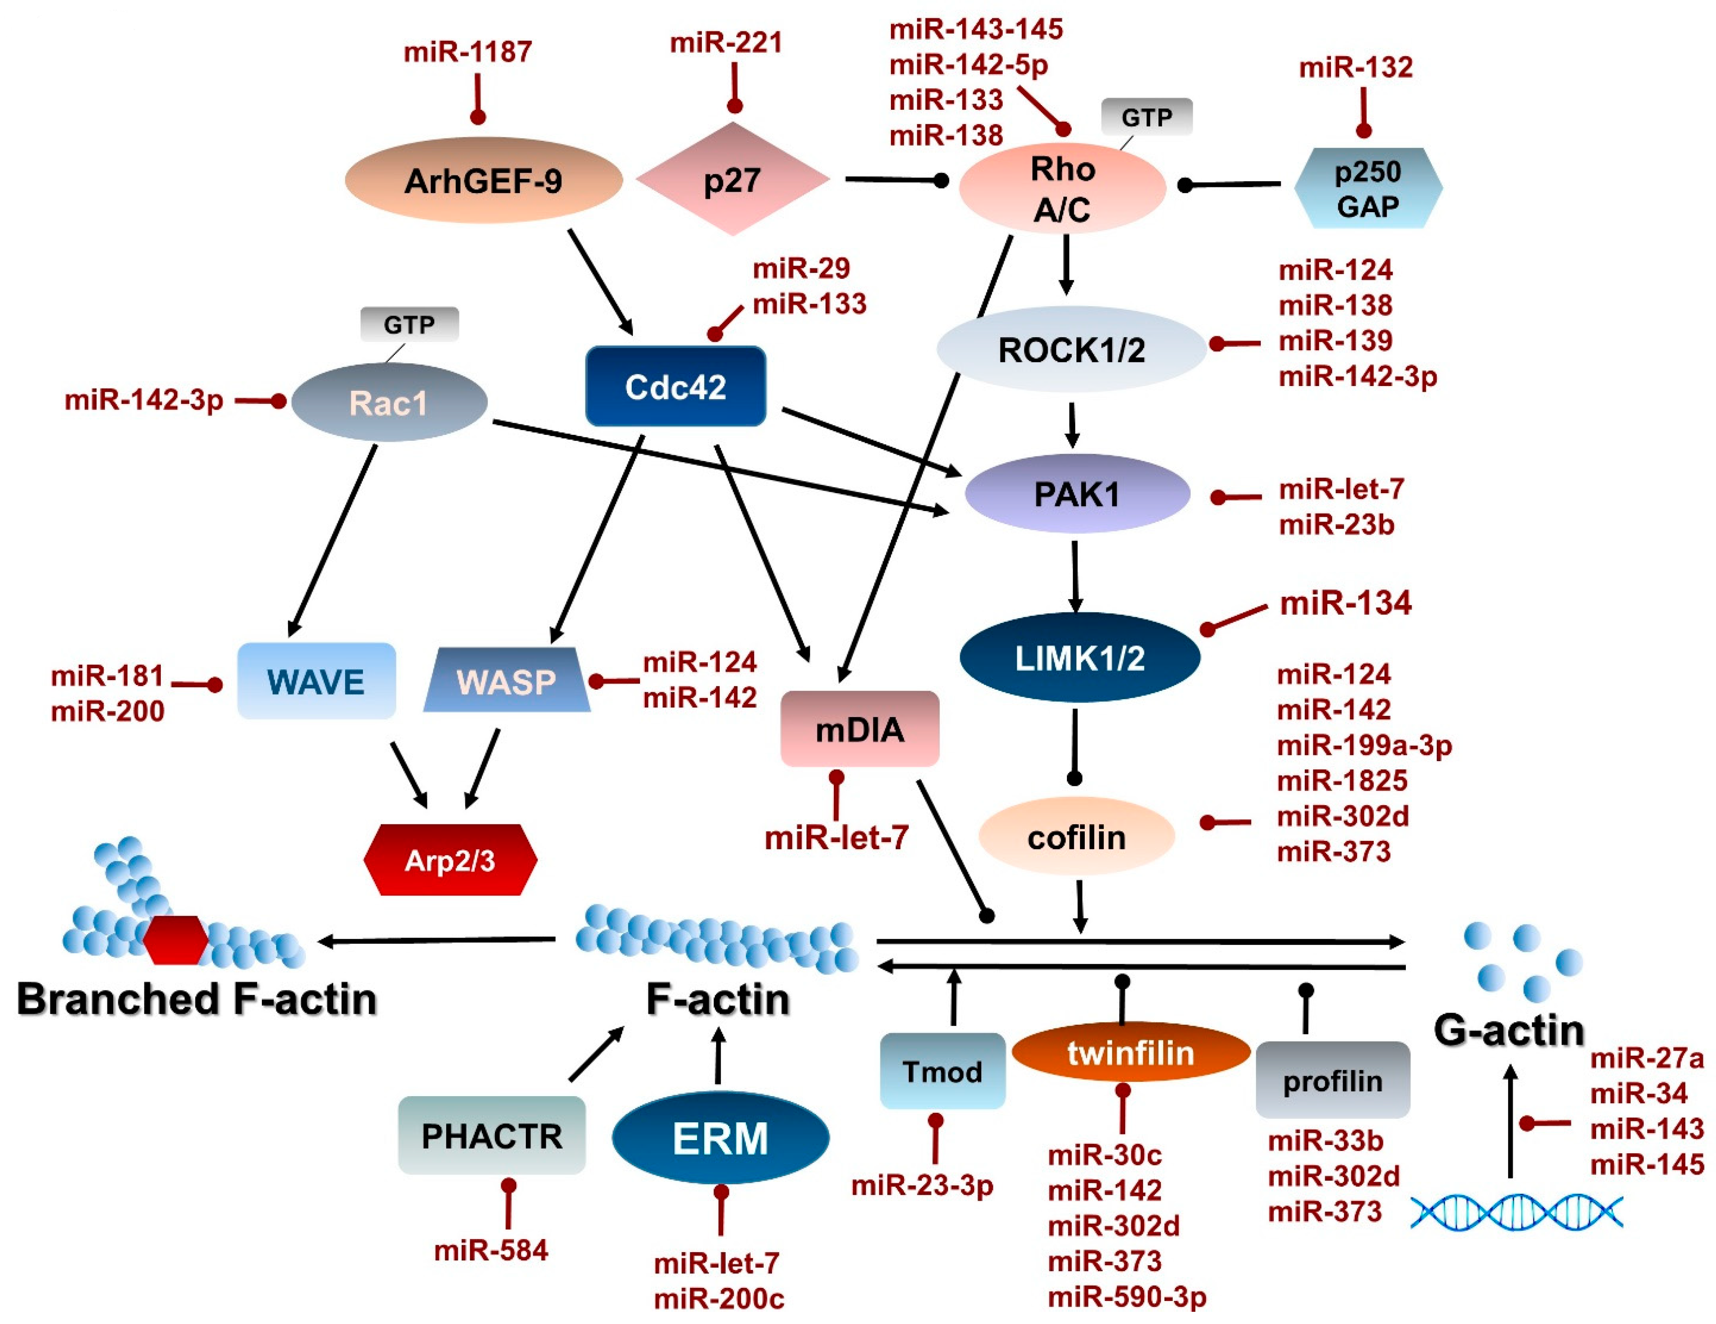

Slide 22
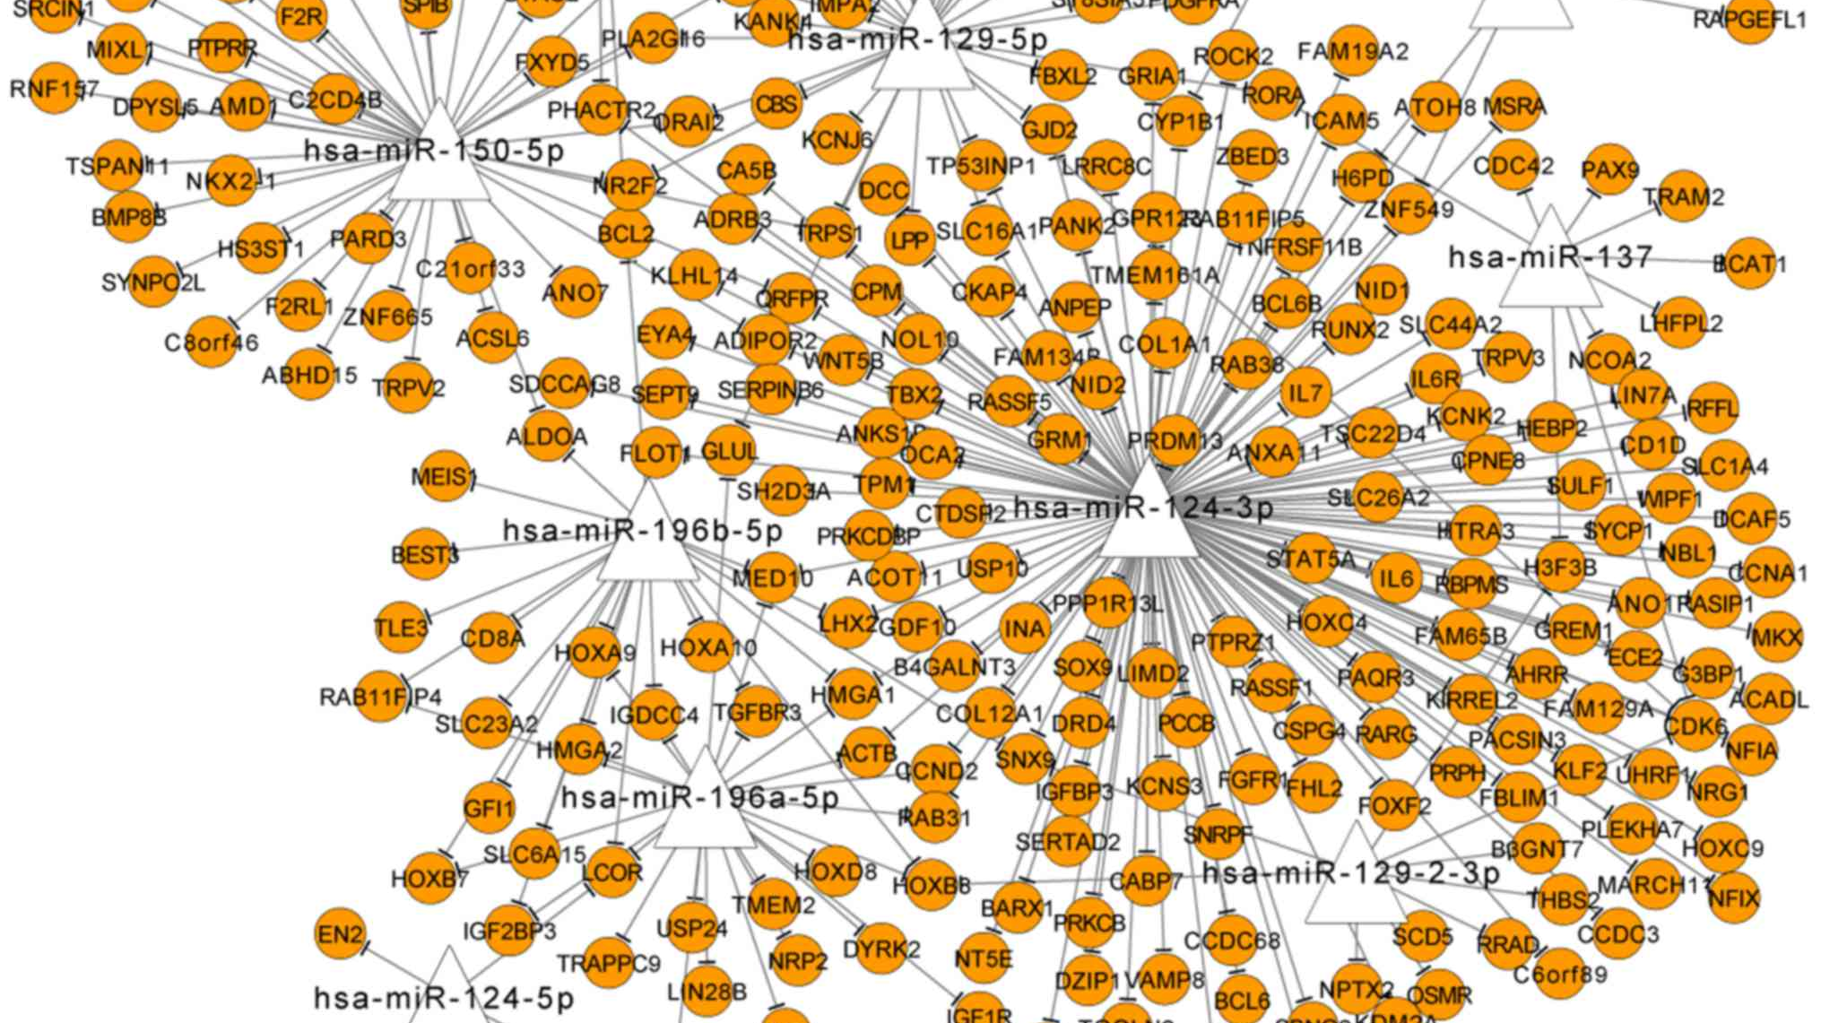

Slide 23
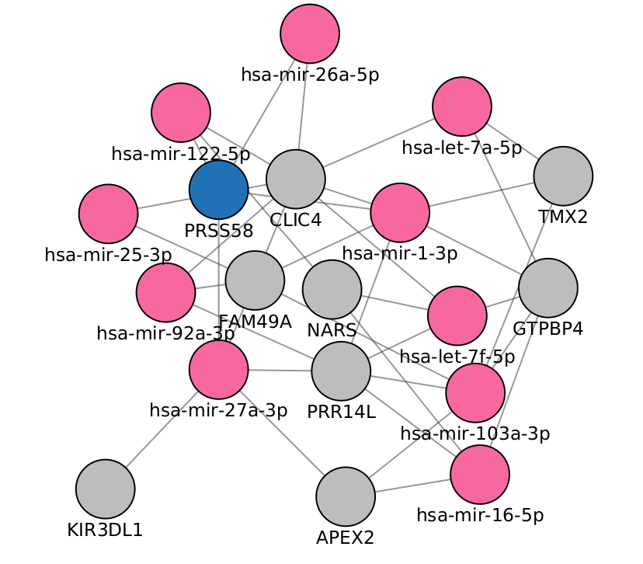

Computational models to understand

Slide 24
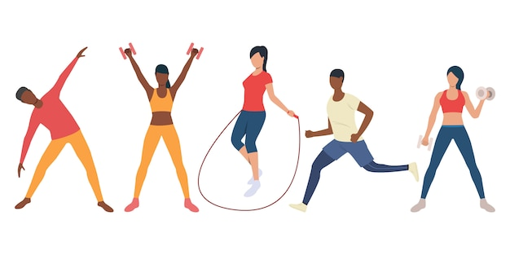
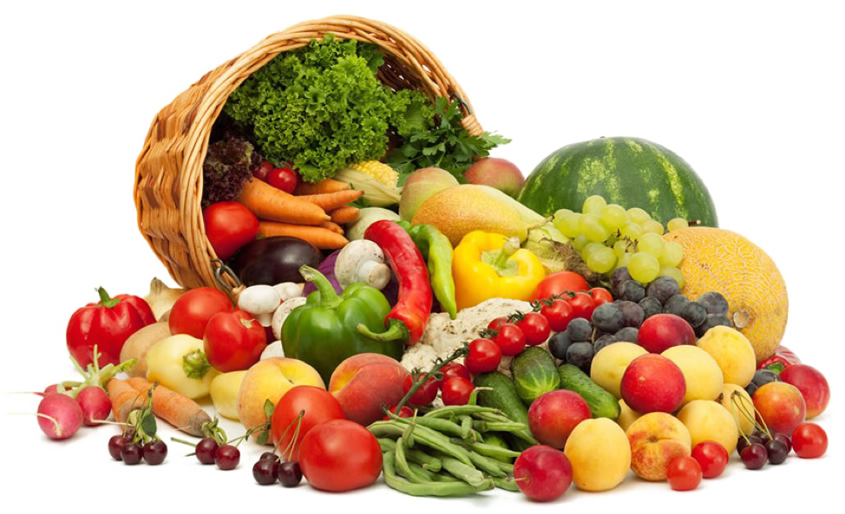
In the mean time

Slide 25
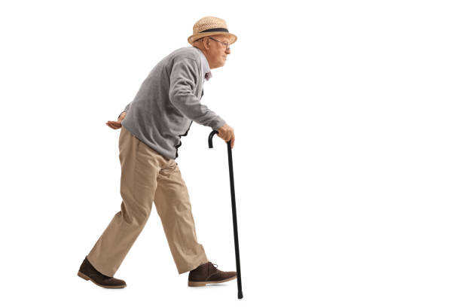
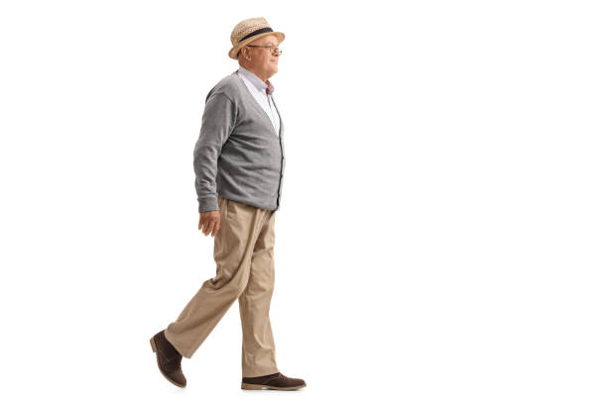

Slide 26
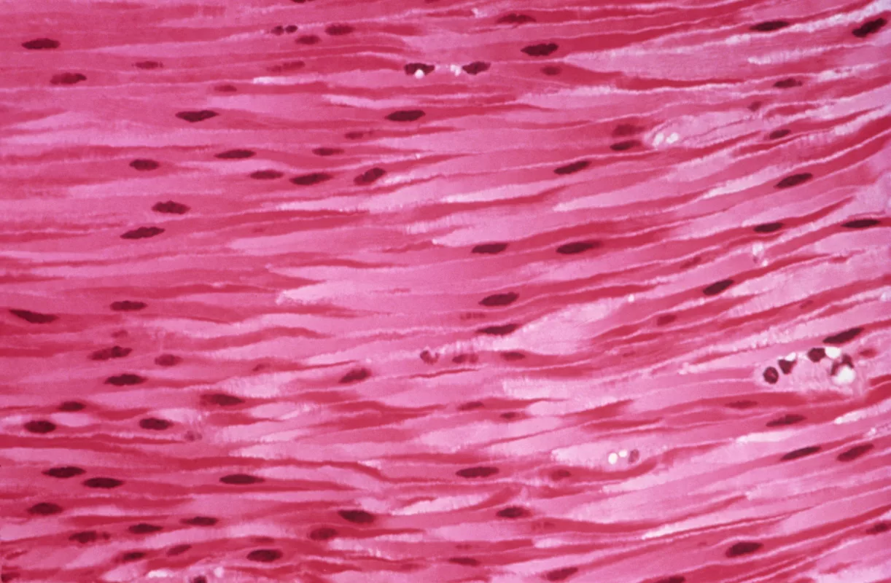
THANK
Karen Guerrero Vazquez
K.GuerreroVazquez1@nuigalway.ie
You

Slide 27
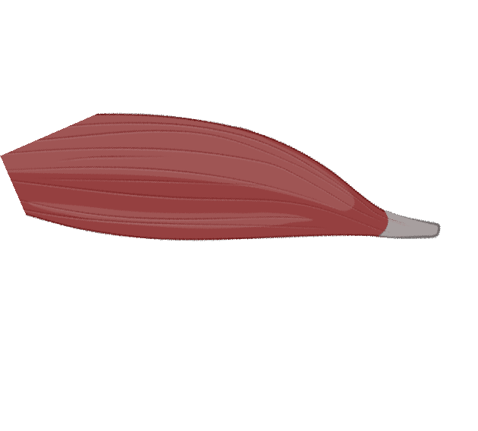


Slide 28
Transcription regulation
Micro RNA

Slide 29


Secret of youth

Slide 30
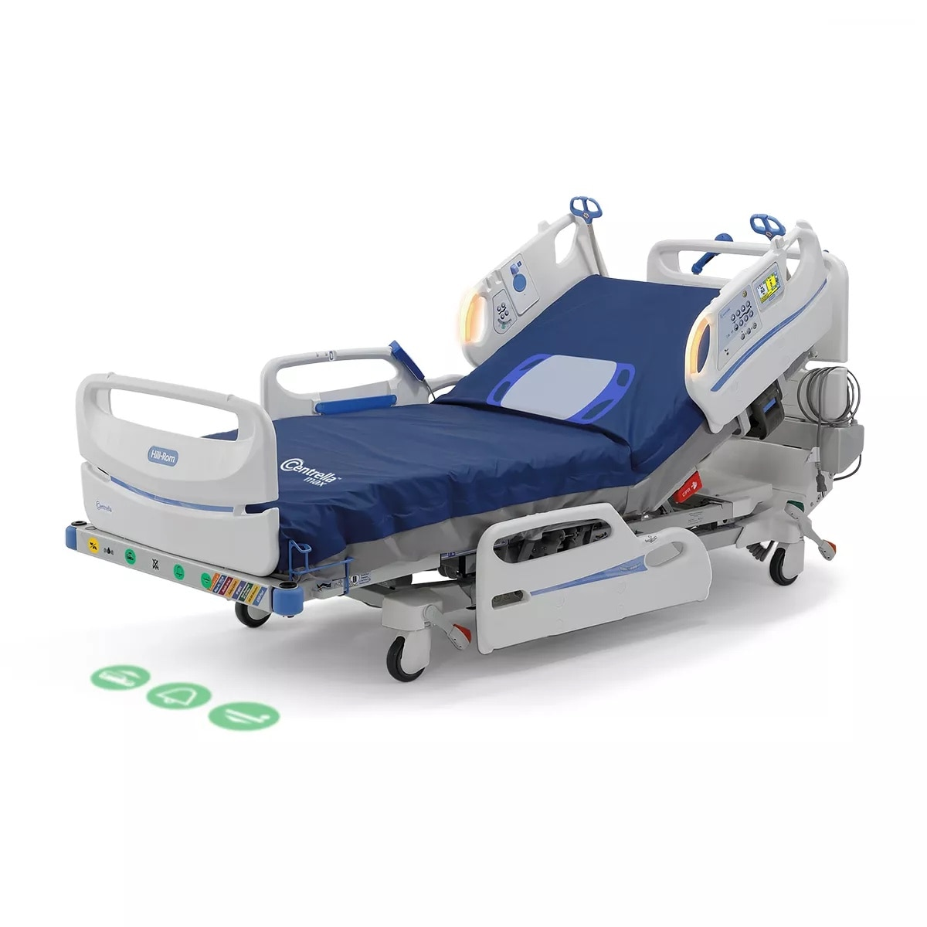

Slide 31

PRIMARY GOALS
Annual Revenue Growth

Slide 32
QUARTERLY PERFORMANCE

Slide 33
AREAS OF GROWTH
 | B2B | Supply chain | ROI | E-commerce
Q1 | 4.5 | 2.3 | 1.7 | 5.0
Q2 | 3.2 | 5.1 | 4.4 | 3.0
Q3 | 2.1 | 1.7 | 2.5 | 2.8
Q4 | 4.5 | 2.2 | 1.7 | 7.0

Slide 34

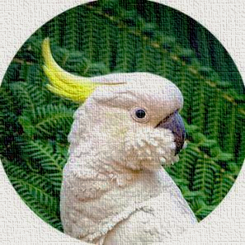
“BUSINESS OPPORTUNITIES ARE LIKE BUSES. THERE’S ALWAYS ANOTHER ONE COMING. ”
Richard Branson

Slide 35

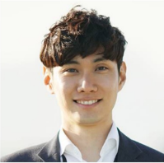
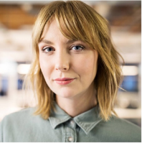
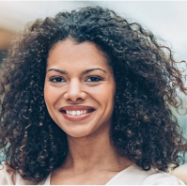
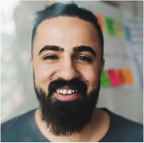
MEET OUR TEAM
TAKUMA HAYASHI​
MIRJAM NILSSON​
FLORA BERGGREN​
RAJESH SANTOSHI​
President
Chief Executive Officer
Chief Operations Officer
VP Marketing

Slide 36
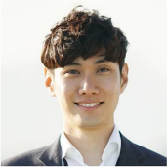

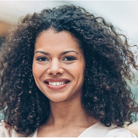

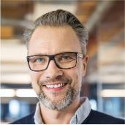
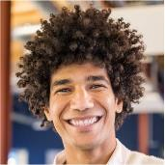
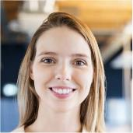
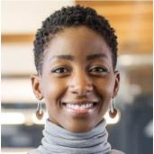
MEET OUR EXTENDED TEAM
TAKUMA HAYASHI​
MIRJAM NILSSON​
FLORA BERGGREN​
RAJESH SANTOSHI​
President
Chief Executive Officer
Chief Operations Officer
VP Marketing
GRAHAM BARNES
ROWAN MURPHY
ELIZABETH MOORE
ROBIN KLINE
VP Product
SEO Strategist
Product Designer
Content Developer

Slide 37
PLAN FOR PRODUCT LAUNCH
Deploy strategic networks with compelling e-business needs
PLANNING
Synergize scalable e-commerce
MARKETING
Disseminate standardized metrics
DESIGN
Coordinate e-business applications
Foster holistically superior methodologies
LAUNCH
STRATEGY

Slide 38

TIMELINE
Sep 20XX
Nov 20XX
Jan 20XX
Mar 20XX
May 20XX
Synergize scalable e-commerce
Disseminate standardized metrics
Coordinate e-business applications
Foster holistically superior methodologies
Deploy strategic networks with compelling e-business needs

Slide 39

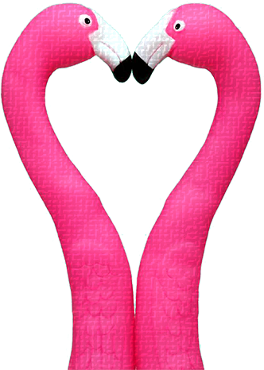
AREAS OF FOCUS
B2B MARKET SCENARIOS
Develop winning strategies to keep ahead of the competition
Capitalize on low-hanging fruit to identify a ballpark value
Visualize customer directed convergence
CLOUD-BASED OPPORTUNITIES
Iterative approaches to corporate strategy
Establish a management framework from the inside

Slide 40
HOW WE GET THERE
ROI
NICHE MARKETS
SUPPLY CHAINS
Envision multimedia-based expertise and cross-media growth strategies​
Visualize quality intellectual capital​
Engage worldwide methodologies with web-enabled technologies
Pursue scalable customer service through sustainable strategies​
Engage top-line web services with cutting-edge deliverables
Cultivate one-to-one customer service with robust ideas​
Maximize timely deliverables for real-time schemas

Slide 41

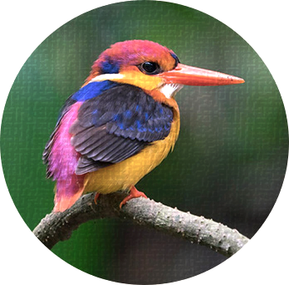
SUMMARY
At Contoso, we believe in giving 110%. By using our next-generation data architecture, we help organizations virtually manage agile workflows. We thrive because of our market knowledge and great team behind our product. As our CEO says, "Efficiencies will come from proactively transforming how we do business."​
​

